Slide 1
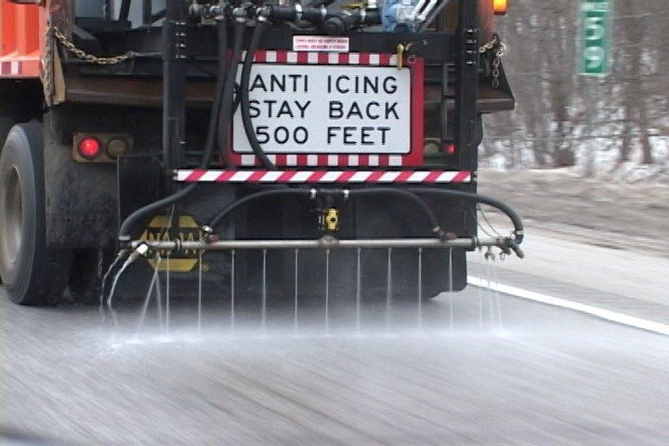

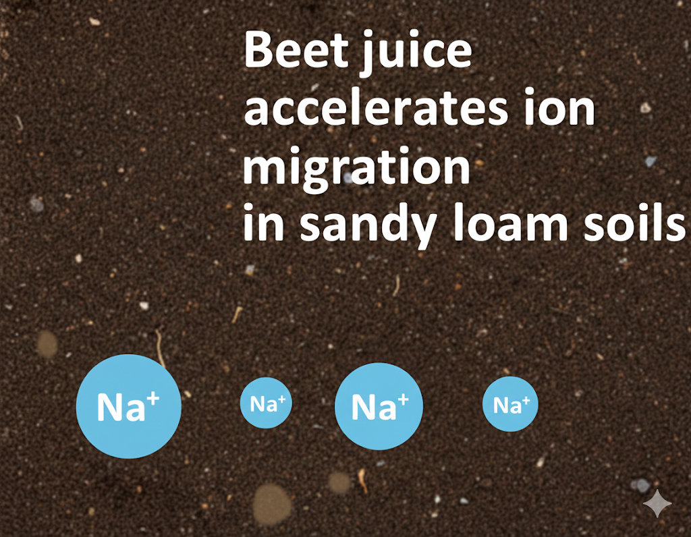

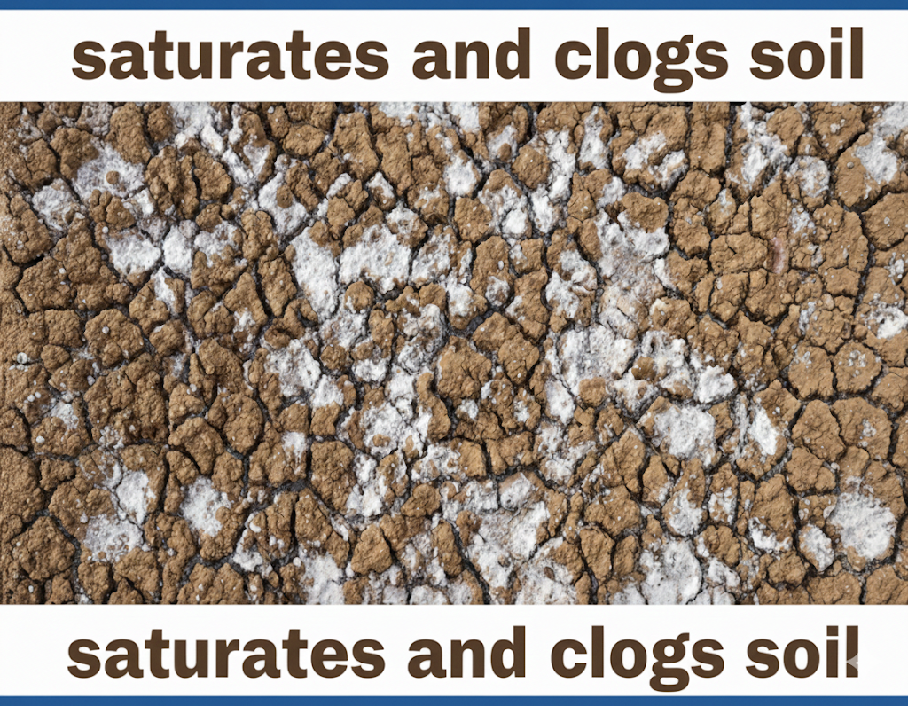




Transport of Sodium Chloride Deicer and Organic Additive through Roadside Soils
Pathway to Roadside Soils
Runoff of precipitation and snowmelt
Deposition from snow ploughing
Splash and spray action during application
Wind action
Leakage from storage containers
Concentrations applied on-site
Roadside Soil Particle Fraction
Sodium chloride (NaCl) (23% wt.)
Beet juice (20% wt. of NaCl solution)
Clay (~7.46%)
Silt (~40.35%)
Sand (~52.17%)
Effect of beet juice addition on Ion adsorption
At equilibrium conditions, beet juice increases the adsorption of sodium ions in the soil but reduces the adsorption of chloride ions.
At non-equilibrium conditions, beet juice reduces the adsorption of sodium ions and chloride ions in the soil.
👎
Consd
Increased soil salinity
What actions should we take?
Monitor roadside salinity in agricultural zone
Use organic additives judiciously: they may accelerate ion migration
Prioritize site-specific testing before high-volume salt use

Slide 2
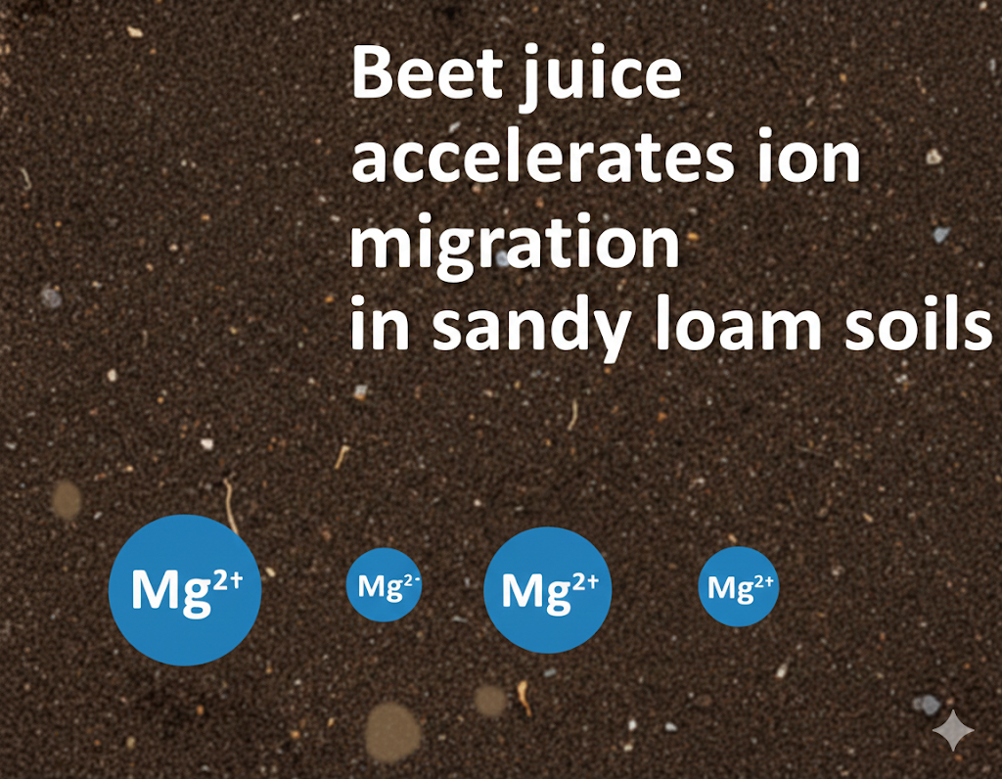
Transport of Magnesium Chloride Deicer and Organic Additive through Roadside Soils
Pathway to Roadside Soils
Runoff of precipitation and snowmelt
Deposition from snow ploughing
Splash and spray action during application
Wind action
Leakage from storage containers
Concentrations applied on-site
Roadside Soil Particle Fraction
Magnesium chloride (MgCl₂) (30% wt.)
Beet juice (20% wt. of MgCl₂ solution)
Clay (~7.46%)
Silt (~40.35%)
Sand (~52.17%)
Effect of beet juice addition on Ion adsorption
At equilibrium conditions, beet juice increases the adsorption of magnesium ions in the soil but decreases the adsorption of chloride ions.
At non-equilibrium conditions, beet juice decreases the adsorption of magnesium ions and chloride ions in the soil.
👎
Cons
Increased soil salinity
What actions should we take?
Monitor roadside salinity in agricultural zone
Use organic additives judiciously: they may accelerate ion migration
Prioritize site-specific testing before high-volume salt use

